Slide 1

Unveiling Customer Shopping Behavior
This project analyzes 3,900 purchases to uncover insights into spending patterns, customer segments, and product preferences, guiding strategic business decisions.

Slide 2

Project Overview
Data-Driven Decisions
Insight Generation
Utilize transactional data to inform business strategies.
Uncover patterns in spending, segmentation, and product choices.
Strategic Guidance
Provide actionable recommendations for growth and efficiency.

Slide 3
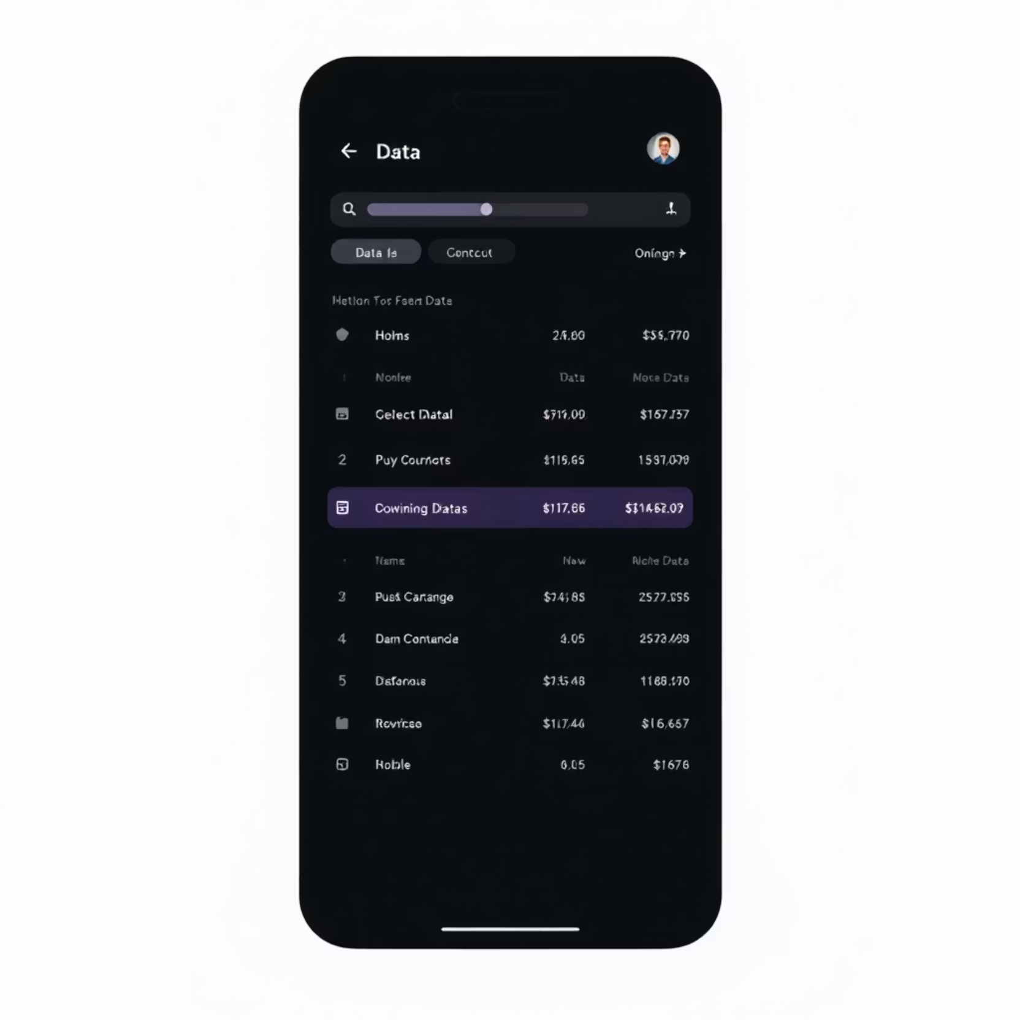
Dataset Summary
Our analysis is based on a robust dataset of 3,900 rows and 18 columns, capturing a comprehensive view of customer interactions.
Customer demographics (Age, Gender, Location, Subscription Status)
Purchase details (Item, Category, Amount, Season, Size, Color)
Shopping behavior (Discount, Promo Code, Previous Purchases, Frequency, Review, Shipping)

Slide 4
Exploratory Data Analysis (EDA) in Python
We initiated our analysis with meticulous data preparation and cleaning using Python.
01
02
03
Data Loading & Exploration
Missing Data Handling
Column Standardization
Imported dataset with pandas, checked structure and summary statistics.
Imputed 37 missing 'Review Rating' values using median per category.
Renamed columns to snake_case for improved readability.
04
05
Feature Engineering
Database Integration
Created 'age_group' and 'purchase_frequency_days' columns.
Loaded cleaned data into PostgreSQL for SQL analysis.

Slide 5

SQL Analysis: Key Business Transactions
Structured SQL queries revealed critical insights into customer behavior and revenue drivers.
1
2
Revenue by Gender
High-Spending Discount Users
Male customers generated significantly more revenue ($157,890) than female customers ($75,191).
Identified 839 customers who used discounts but still spent above average.
3
4
Top 5 Products by Rating
Shipping Type Comparison
Gloves, Sandals, Boots, Hat, and Skirt received the highest average review ratings.
Express shipping users had a slightly higher average purchase amount ($60.48) than Standard ($58.46).

Slide 6
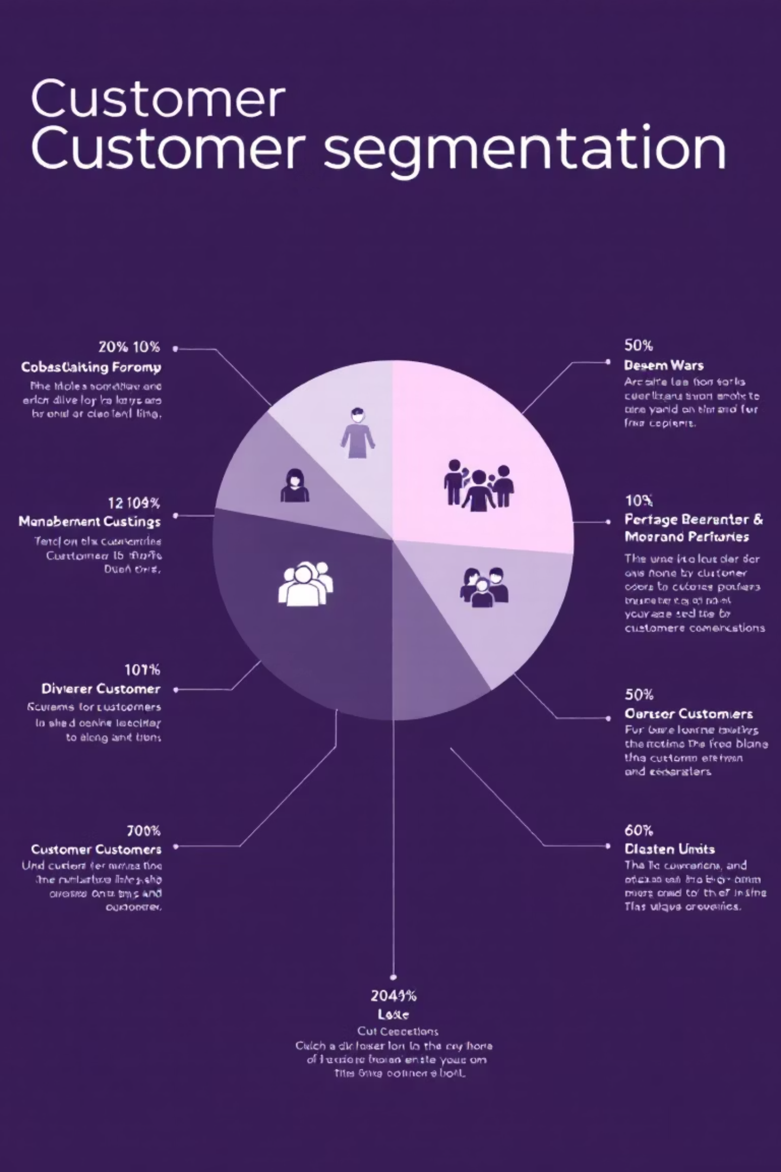
SQL Analysis: Customer & Product Deep Dive
Further SQL analysis provided a deeper understanding of customer segments and product performance.
1
Subscribers vs. Non-Subscribers
Non-subscribers (2847) contributed more total revenue ($170,436) than subscribers (1053) ($62,645).
2
Discount-Dependent Products
Hat (50%), Sneakers (49.66%), and Coat (49.07%) had the highest percentage of discounted purchases.
3
Customer Segmentation
Loyal customers (3116) form the largest segment, followed by Returning (701) and New (83).
4
Repeat Buyers & Subscriptions
Repeat buyers (>5 purchases) are more likely to be non-subscribers (2518) than subscribers (958).

Slide 7
Top Products per Category
Identifying the most purchased items within each category helps optimize inventory and marketing.
1
Accessories
Jewelry
171
1
Clothing
Blouse
171
1
Footwear
Sandals
160
1
Outerwear
Jacket
163

Slide 8
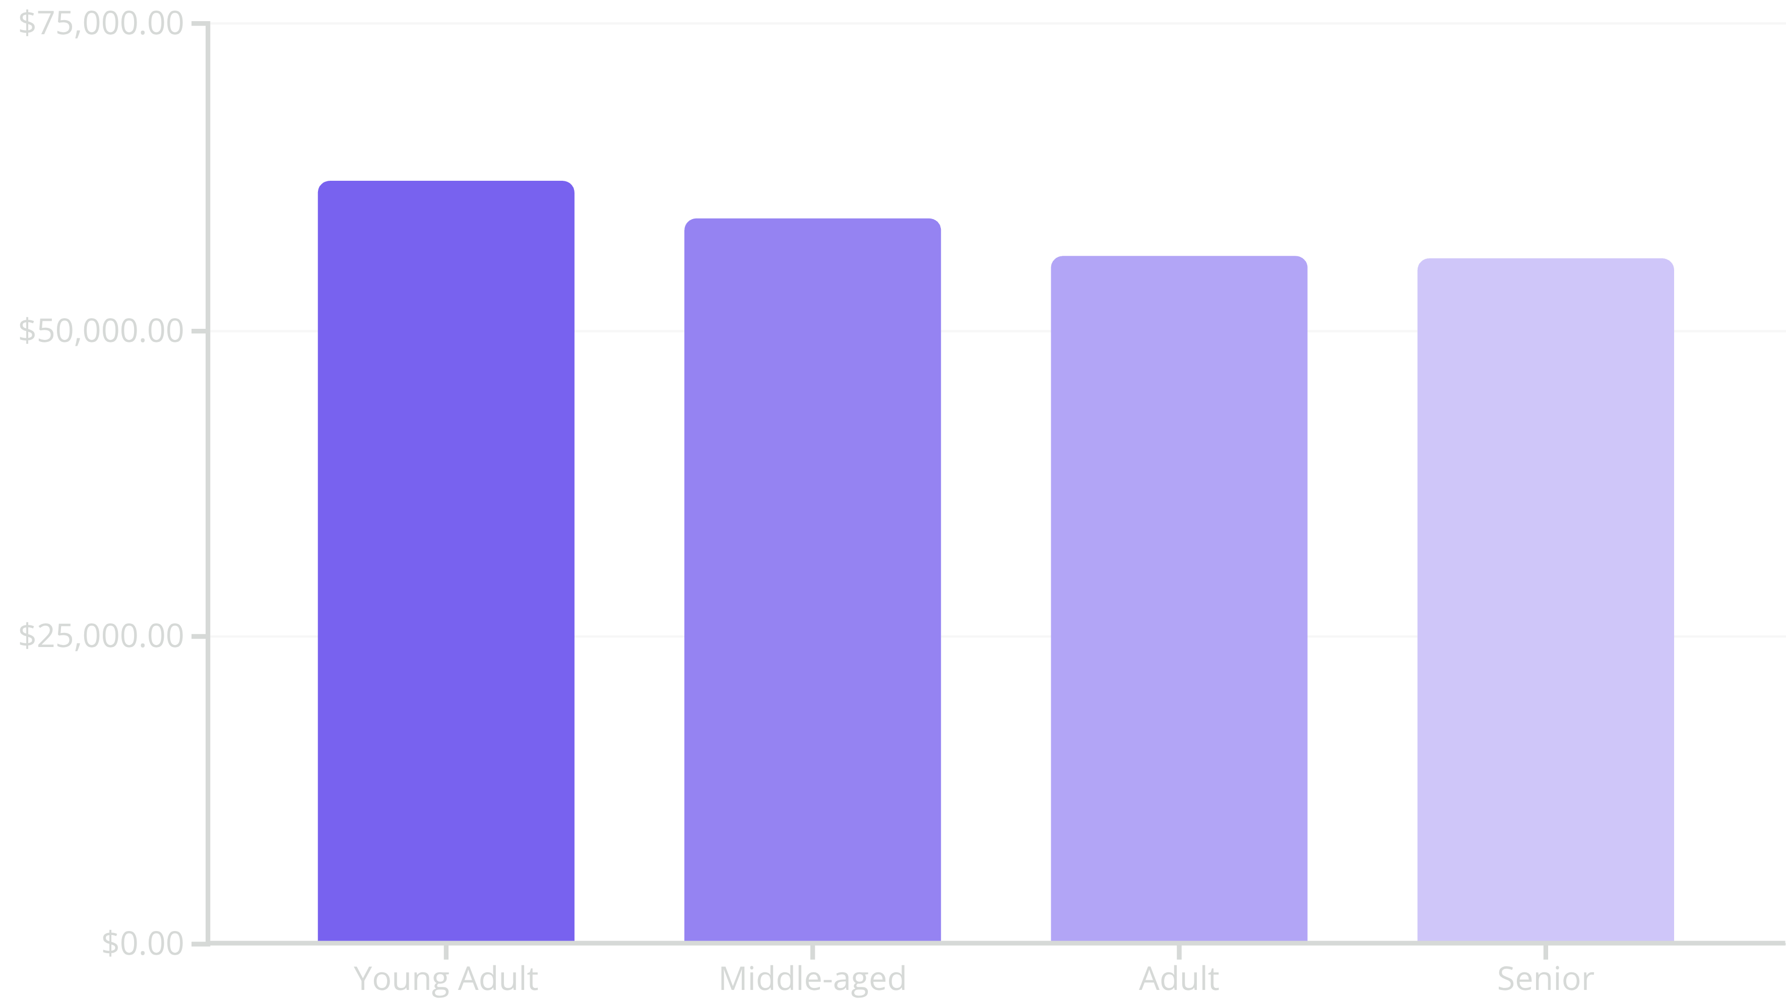
Revenue by Age Group
Understanding revenue contribution by age group allows for targeted marketing campaigns.

Slide 9
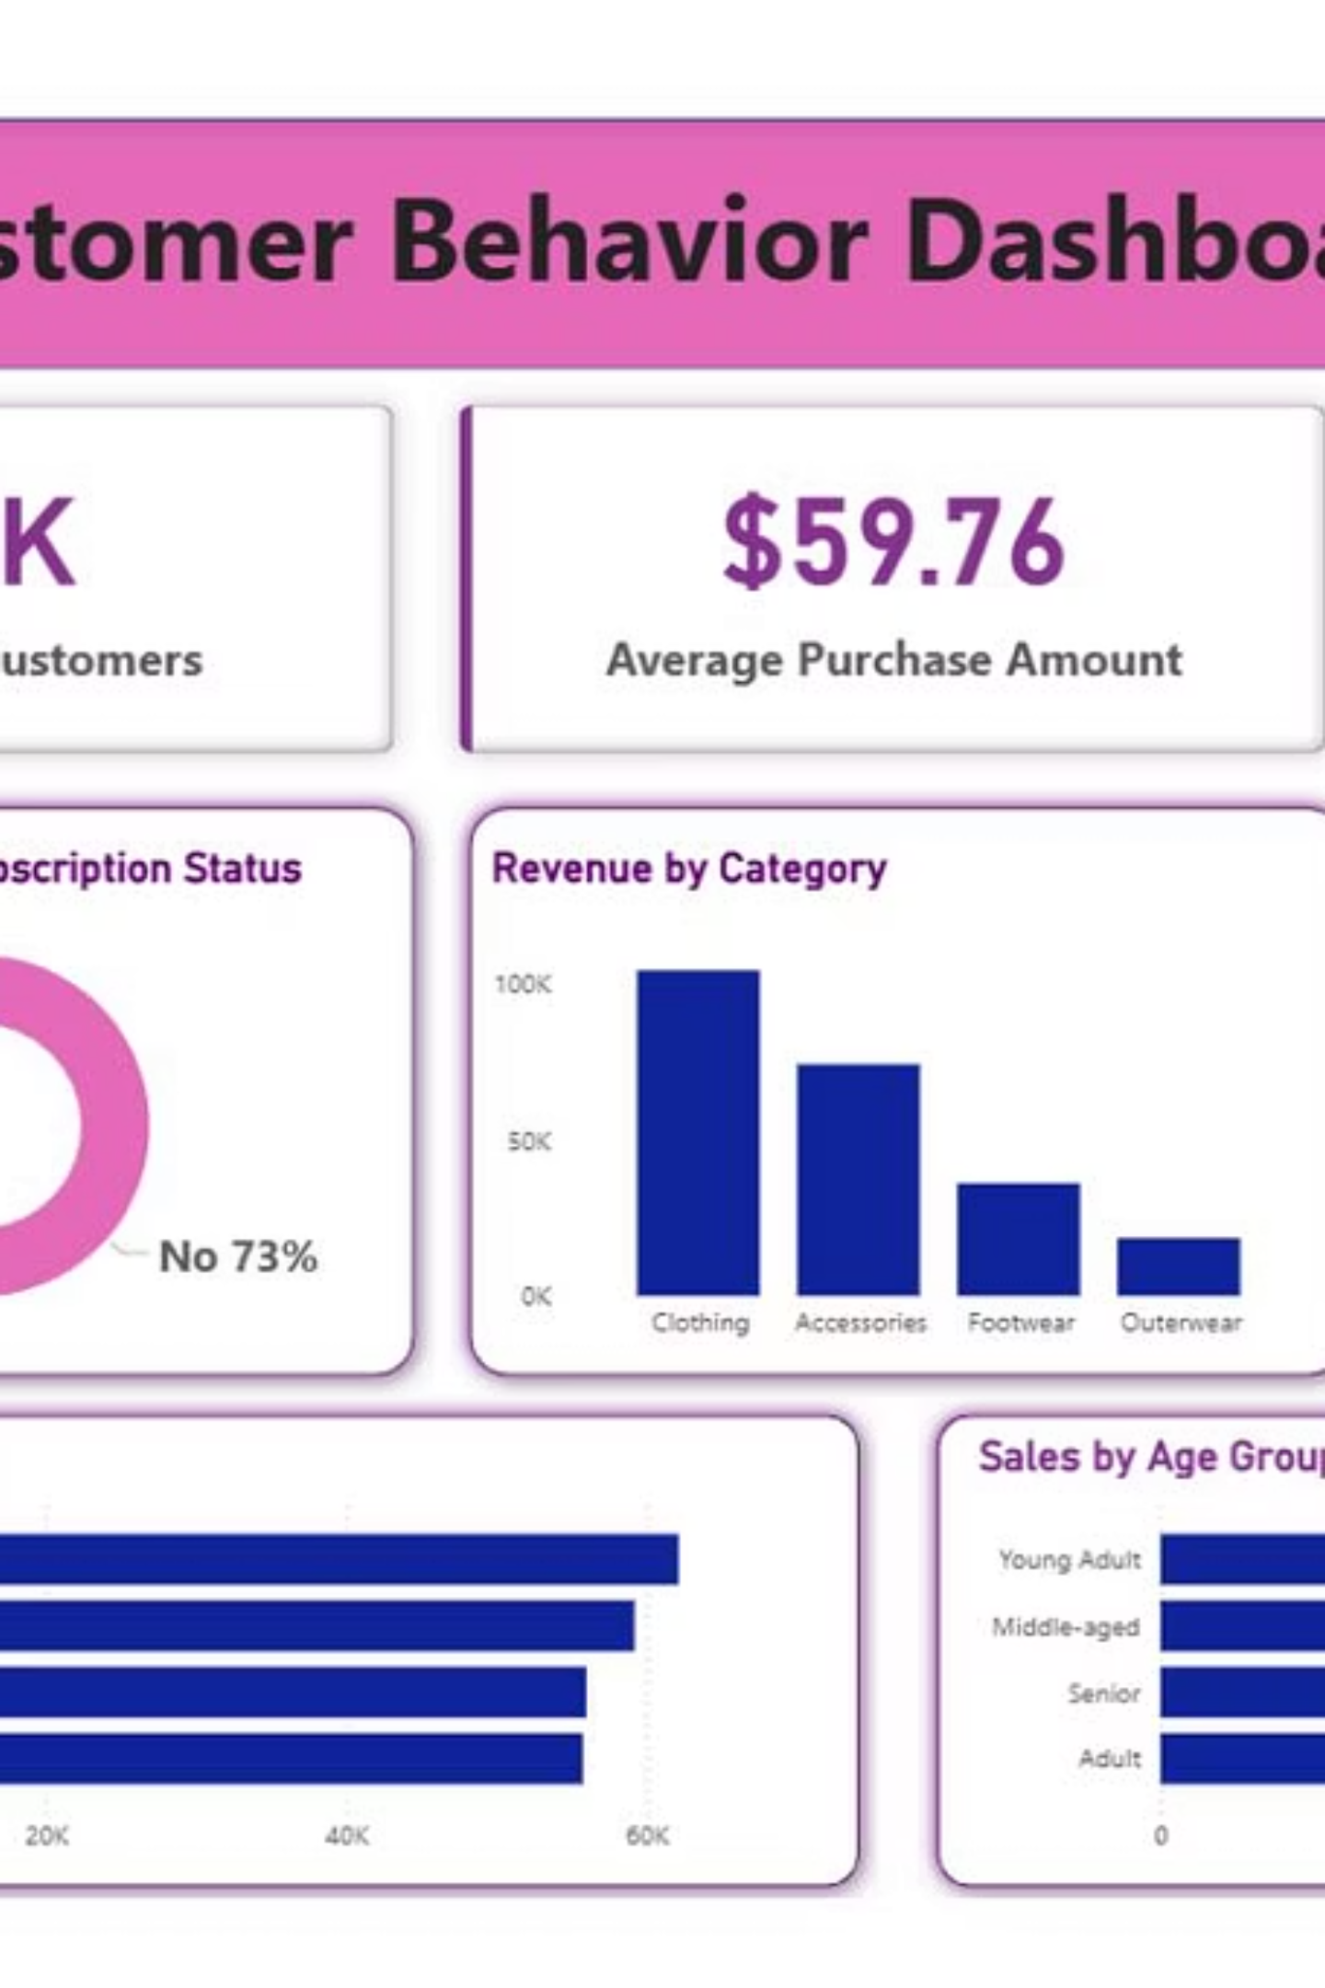
Power BI Dashboard
An interactive Power BI dashboard was developed to visualize these insights, providing a dynamic tool for business users.
The dashboard allows for real-time exploration of data, enabling quick decision-making and performance monitoring.

Slide 10

Business Recommendations
Boost Subscriptions
Promote exclusive benefits to increase subscriber base and engagement.
Customer Loyalty Programs
Implement rewards to convert returning customers into loyal segments.
Review Discount Policy
Optimize discount strategies to balance sales growth with profit margins.
Product Positioning
Highlight top-rated and best-selling products in marketing campaigns.
Targeted Marketing
Focus efforts on high-revenue age groups and express-shipping users for maximum impact.

